Slide 1

Testing and Debugging
CS 1181 – Computer Science II
Dr. Michael Raymer
Lecture materials adapted from:
ZyBooks ISBN: 979-8-203-16123-9 Dr. Cay Horstmann, Univ. of Michigan Dr. Roman Lysecky, Univ. of Arizona
Dr. Adrian Lizarraga, Univ. of Arizona
Dr. Travis Doom
Dr. Michelle Cheatham
Unless otherwise noted images are used under the creative commons license or used under license from Adobe Stock.

Slide 2
When things go wrong
The debugger is your friend!
Did I make a deep copy?
Did the copy constructor run?
Which method am I in?
Why did I get an exception?

Slide 3
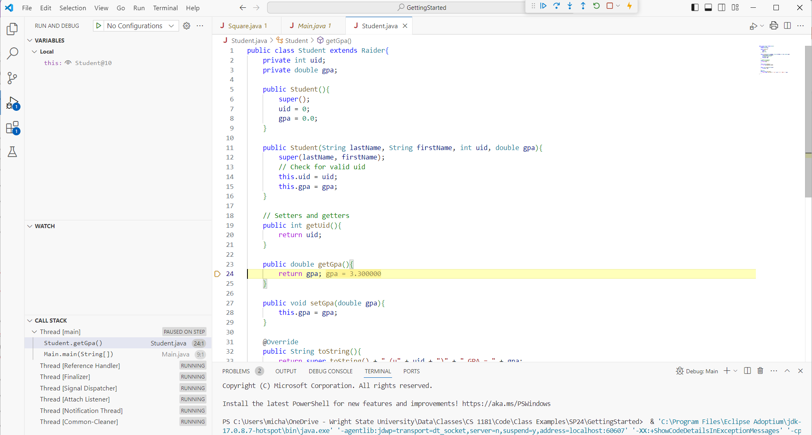
Using the Debugger

Slide 4
Exceptions: Catching Errors Early
Why throw an exception on purpose?
ExceptionSquare example – catching an error while we know where the problem is.
Two kinds of exceptions to throw:
Checked: problems likely! Better force the programmer to have a back up plan.
Unchecked: Go ahead and give it a shot!

Slide 5
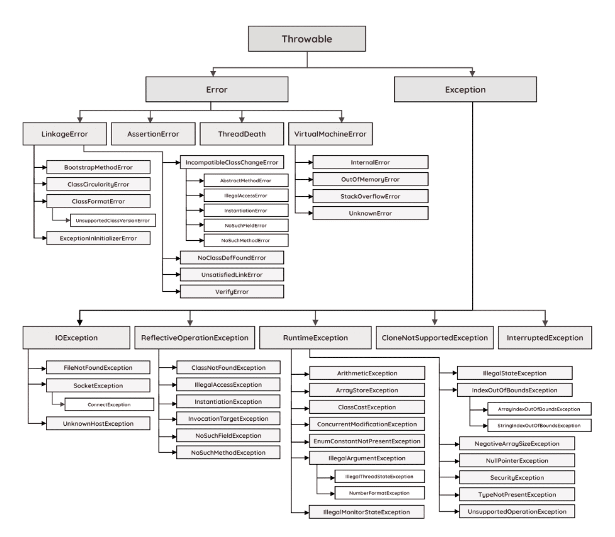



The Java Exception Hierarchy
Checked

Slide 6
Catching Exceptions
To catch or not to catch?
The catch hierarchy:
public void someMethod(){
try {
dangerousThing();
} catch (FileNotFoundException e) {
System.out.println("Unable to open file!");
System.out.println(e.getMessage());
} catch (Exception e) {
System.out.println("Unknown problem");
e.printStackTrace();
return;
} finally {
System.out.println("This code always runs, even if an exception happens!");
}
System.out.println("This will run if there is a FileNotFoundException (or no exception)");
System.out.println("but NOT if there is some other exception. Why??");
}

Slide 7
Got it?
What would be printed?
int[] arr = { 1, 2, 3, 4, 5 };
try {
System.out.println(arr[9]);
System.out.println(1);
} catch (ArithmeticException e1) {
System.out.println(2);
} catch (ArrayIndexOutOfBoundsException e2) {
System.out.println(3);
} catch (NullPointerException e3) {
System.out.println(4);
} catch (Exception e4) {
System.out.println(5);
} finally {
System.out.println(6);
}
System.out.println(7);

Slide 8


Unit Testing
The best way to avoid big, nasty bugs is to test early and test often
Java’s JUnit framework makes it easy
Start here:
Write some @Tests
org.junit.Assert some things
assertEquals
assertArrayEquals
assertTrue/assertFalse
assertSame …

